Slide 1
CEGE0004: Machine Learning for Data Science Lecture 7: Computational Learning Theory Dr. Aldo Lipani

Slide 2
Computational Learning Theory
We have seen many learning algorithms.
Which one is the best?
Some may be preferred because of their lower computational complexity, other because of their ability to include prior knowledge.
Given two classifiers that perform equally well on a training set,
the simple classifier is usually preferred; (is the Occam's Razor so evident?)
or we impose smoothness on decision functions.
Do these simpler or smother classifiers generalize better?

Slide 3
Computational Learning Theory
In some fields there are strict conservation and constraint laws:
Conservation of energy, charge and momentum;
Second law of thermodynamics.
These hold regardless of the number and configuration of the forces at play.
Are there analogous results in machine learning, ones that do not depend upon a particular choice of classifier or learning method?
Are there any fundamental results that hold regardless of the cleverness of the designer, the number of distribution of the patterns and the nature of the task?

Slide 4
Computational Learning Theory
No pattern classification method is inherently superior to any other, or even to random guessing.
It is the type of the problem, prior distribution and other information that determine which learning algorithm is the best.

Slide 5
No Free Lunch Theorem
Are there any reasons to prefer one classifier or learning algorithm over another?
If we make no prior assumptions about the nature of the task, can we expect any classification method to be superior? Can we even find an algorithm that is overall superior?
The no free lunch theorem says no.
There are no context-independent or usage independent reasons to favor one learning or classification method over another. If one algorithm seems to outperform in a particular situation, it is a consequence of its fit to the particular problem.
When confronting a new problem, you should focus on what makes a difference:
prior information, data distribution, amount of training data, and cost of reward functions.
Be skeptical of studies that purport to demonstrate the overall superiority of a particular learning algorithm.

Slide 6
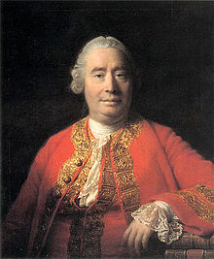
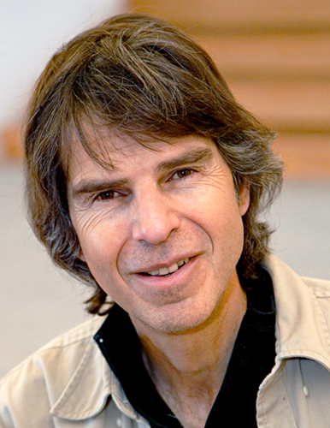

No Free Lunch Theorem
Rationalists vs. Empiricists.
"How can we ever be justified in generalizing from what we've seen to what we haven't?" David Hume
David Wolpert (physicist turned machine learner) sets a limit on how good a learner can be: no learner can be better than random guessing!
There is no such a thing as learning without knowledge. Data alone is not enough.
"The futility of bias-free learning." Tom Mitchell.
In English bias has a negative connotation: it is a preconceived notion. However, preconceived notions are indispensable to human cognition.

Slide 7
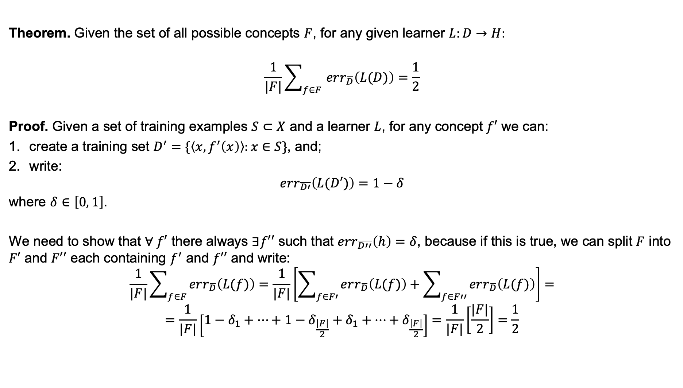
No Free Lunch Theorem for Concepts Learning
Theorem. Given the set of all possible concepts $F$, for any given learner $L:D→H:$
$$\frac{1}{|F|}\sum_{f∈F }{err_{\overline{D}}\left(L(D)\right)=\frac{1}{2}}$$
Proof. Given a set of training examples $S⊂X$ and a learner $L$, for any concept $f′$ we can:
create a training set $D^{′}=\{\left\langle x, f^{′}\left(x\right)\right\rangle :x∈S\}$, and;
write:
$$err_{\overline{D′}}\left(L(D′)\right)=1−δ$$
where $δ∈\left[0, 1\right]$.
We need to show that $∀ f′$ there always $∃f′′$ such that $err_{\overline{D′′}}\left(h\right)=δ$, because if this is true, we can split $F$ into $F′$ and $F′′$ each containing $f^{′}$ and $f′′$ and write:
$$\frac{1}{|F|}\sum_{f∈F }{err_{\overline{D}}\left(L(f)\right)}=\frac{1}{|F|}\left[\sum_{f∈F′ }{err_{\overline{D}}\left(L(f)\right)}+\sum_{f∈F′′ }{err_{\overline{D}}\left(L(f)\right)}\right]=$$
$$=\frac{1}{|F|}\left[1−δ_{1}+…+1−δ_{\frac{\left|F\right|}{2}}+δ_{1}+…+δ_{\frac{\left|F\right|}{2}}\right]=\frac{1}{|F|}\left[\frac{|F|}{2}\right]=\frac{1}{2}$$

Slide 8



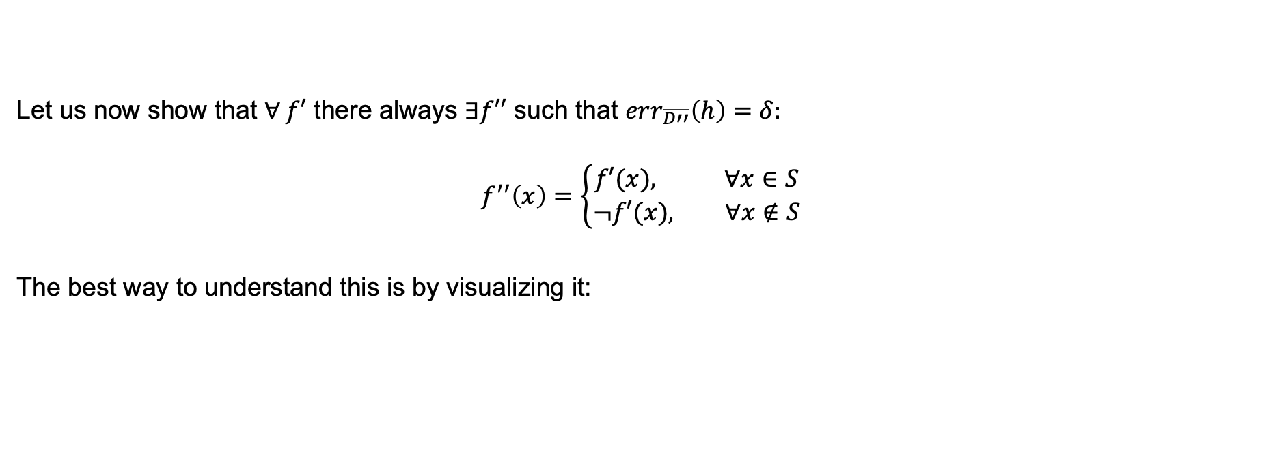






No Free Lunch Theorem for Concepts Learning (II)
Let us now show that $∀ f′$ there always $∃f′′$ such that $err_{\overline{D′′}}\left(h\right)=δ:$
$$f^{′′}\left(x\right)=\left\{\begin{aligned}f′(x), ∀x∈S \\ &¬f′(x), ∀x∉S\end{aligned}\right.$$
The best way to understand this is by visualizing it:
$$f′$$
$$f′′$$
$$S$$
$$S$$
$$X$$
$$X$$
$$\overline{S}$$
$$\overline{S}$$
$$1−δ$$
$$δ$$

Slide 9
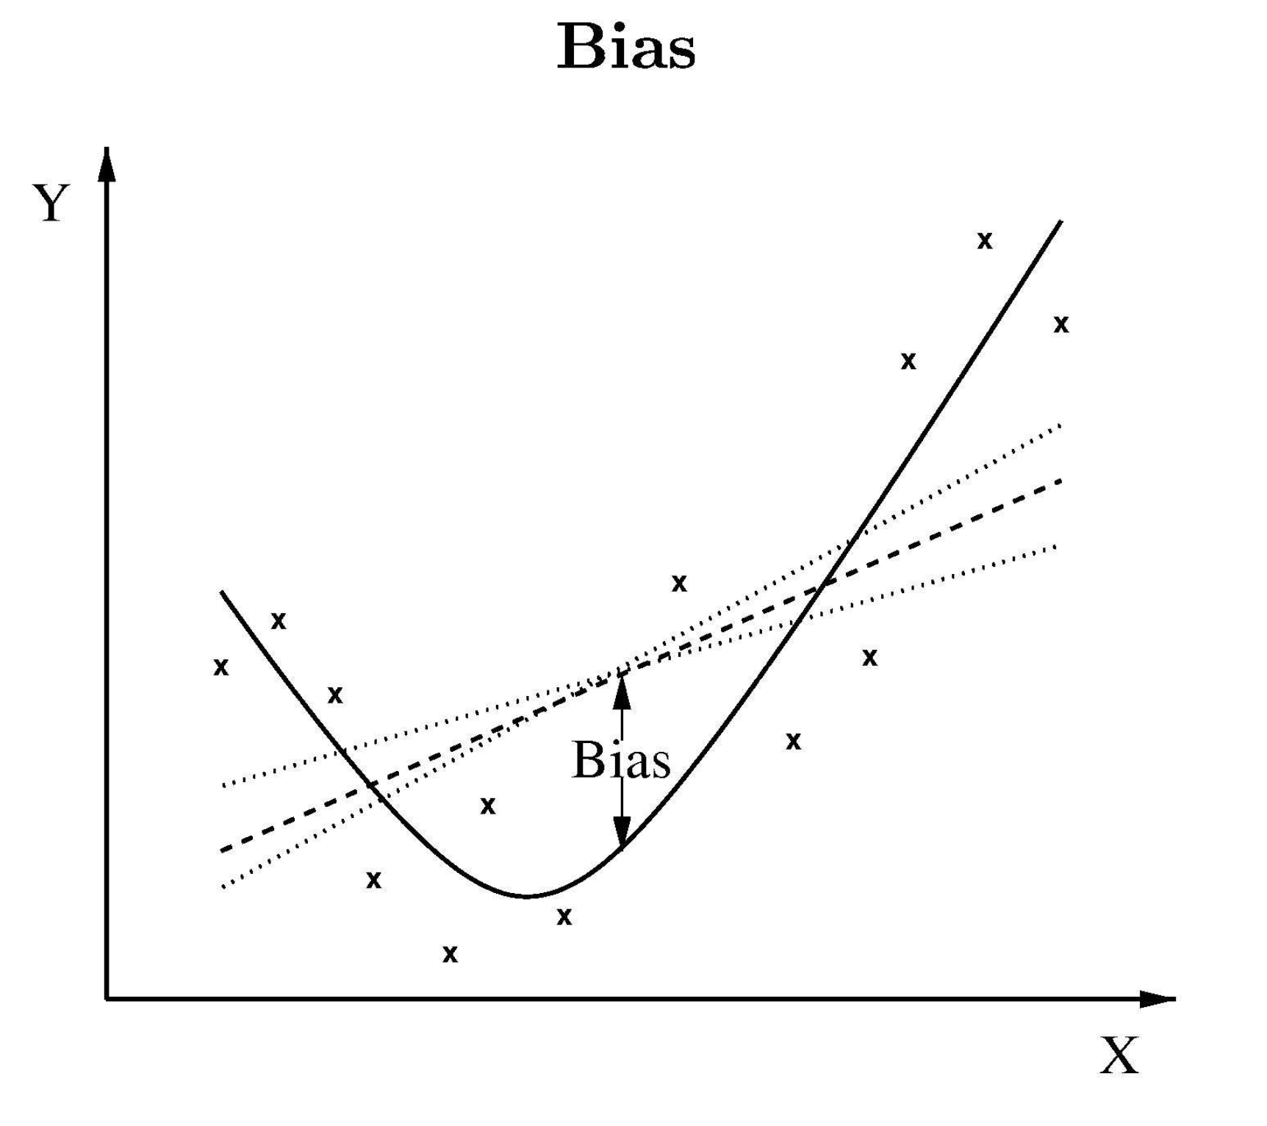
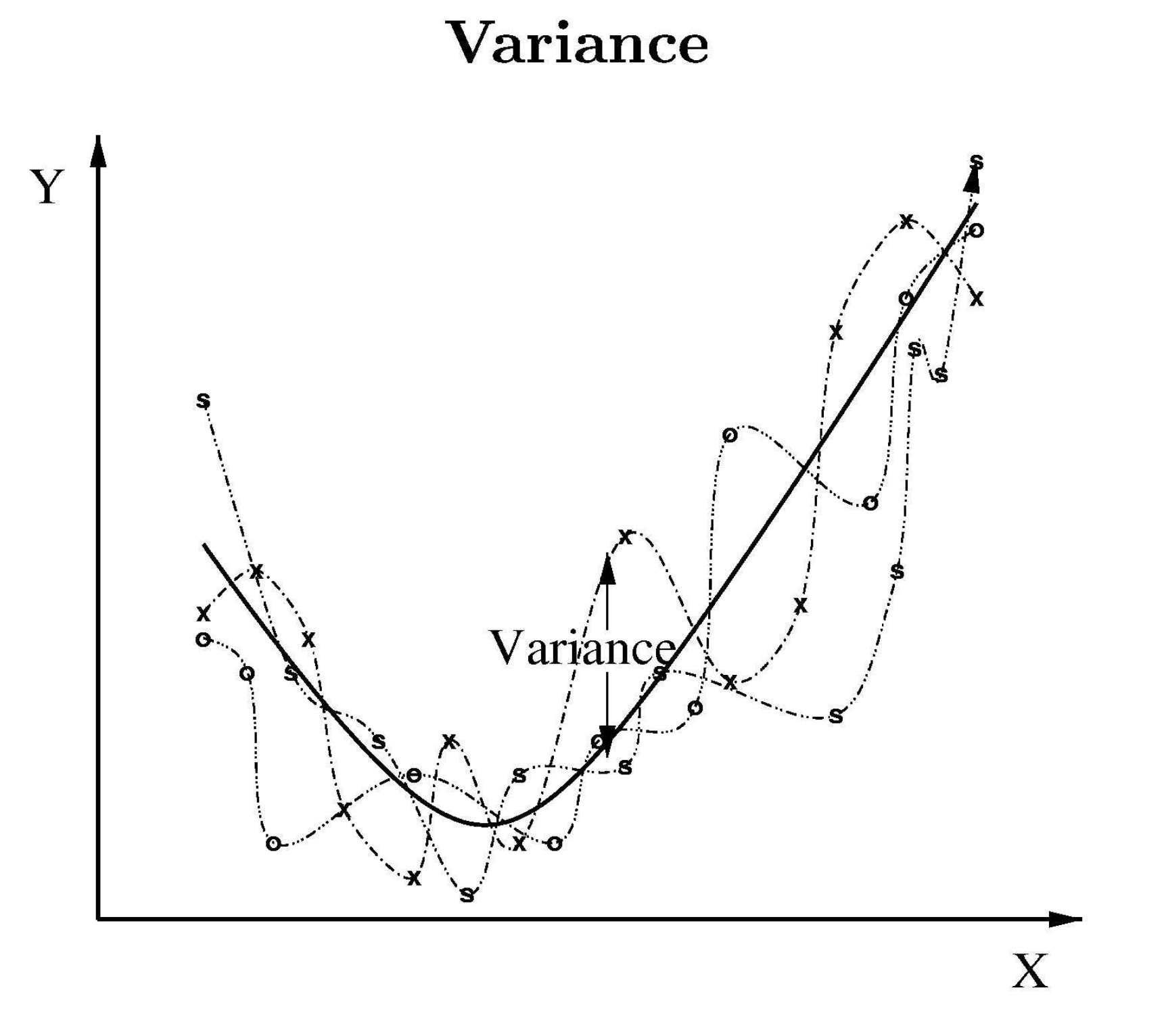
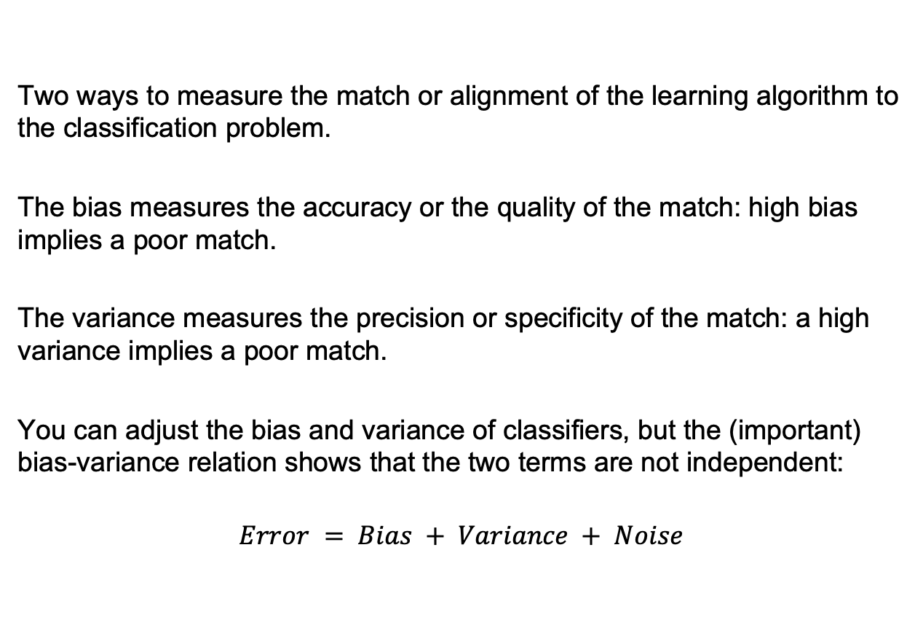
Bias vs. Variance
Two ways to measure the match or alignment of the learning algorithm to the classification problem.
The bias measures the accuracy or the quality of the match: high bias implies a poor match.
The variance measures the precision or specificity of the match: a high variance implies a poor match.
You can adjust the bias and variance of classifiers, but the (important) bias-variance relation shows that the two terms are not independent:
$$Error = Bias + Variance + Noise$$

Slide 10
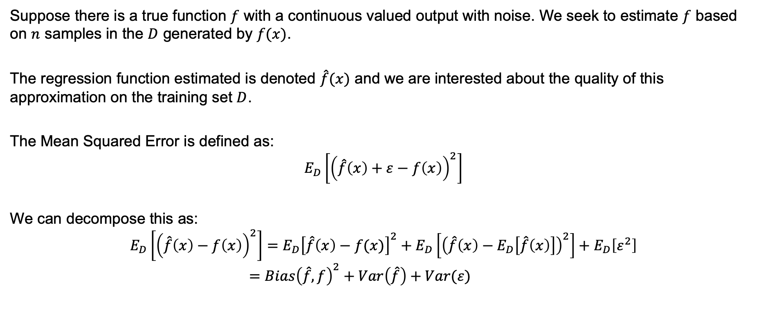
Decomposition for Squared Loss
Suppose there is a true function $f$ with a continuous valued output with noise. We seek to estimate $f$ based on $n$ samples in the $D$ generated by $f(x)$.
The regression function estimated is denoted $\hat{f}(x)$ and we are interested about the quality of this approximation on the training set $D$.
The Mean Squared Error is defined as:
$$E_{D}\left[{\left(\hat{f}\left(x\right)+ε−f\left(x\right)\right)}^{2}\right]$$
We can decompose this as:
$$E_{D}\left[{\left(\hat{f}\left(x\right)−f\left(x\right)\right)}^{2}\right]=E_{D}{\left[\hat{f}\left(x\right)−f(x)\right]}^{2}+E_{D}\left[{\left(\hat{f}\left(x\right)−E_{D}\left[\hat{f}\left(x\right)\right]\right)}^{2}\right]+E_{D}\left[ε^{2}\right]$$
$$=Bias{\left(\hat{f},f\right)}^{2}+Var\left(\hat{f}\right)+Var(ε)$$

Slide 11
Bias Variance Trade-Off
Procedures with increased flexibility to adapt to the training data (more parameters) tend to have lower bias but higher variance.
If the model has few parameters (generally high bias) it may not fit the data well, but this fit will not change much for different data sets (lower variance).
We can virtually never get zero bias and zero variance; to do so would mean that there is only one learning problem to be solved, the answer is already known.
A larger training set will yield a better performance if the model is sufficiently general to represent the target function.
These considerations help to clarify the reasons we seek to have a much accurate prior information about the form of the solution, and as large a training set as feasible; the match of the algorithm to the problem is crucial.

Slide 12
Estimating And Comparing Classifiers
How do we estimate if the classifier is doing well?
Estimating the generalization performance requires making assumptions about the classifier or the problem or both.
The following methods are heuristic. If these were foolproof methods, we could incorporate them into the learning and violate the NFL theorem.
Occasionally our assumptions are explicit but often they are implicit and difficult to identify or relate to the final estimation.

Slide 13
Validation
Training-Validation Sets
K-Fold Cross Validation
Training-Validation-Test Sets
Data
Training
Validation
Fold 1
Fold 2
Fold 3
…
Fold K
Training
Validation
Test

Slide 14
PAC Learning
Under what conditions,
is successful learning possible and impossible?
is a particular learning algorithm assured of learning successfully?
The Probably Approximately Correct (PAC) framework will help us answer these questions.

Slide 15
Complexity and Bounds
Computational complexity
The growth in time or memory required with problem size.
Sample complexity
The growth in the number of required training examples with problem size.
Mistake Bounds
The growth in the number of mistakes before converging to the correct hypothesis.

Slide 16
Probably Learning an Approximately Correct Hypothesis
To identify classes of hypothesis that can and cannot be learned from a polynomial number of training examples.
How many training examples? (Sample complexity)
How much computation is required? (Computational complexity)
We restrict our analysis to Boolean-valued concepts with noise-free data, but this can be extended to more general setups.

Slide 17
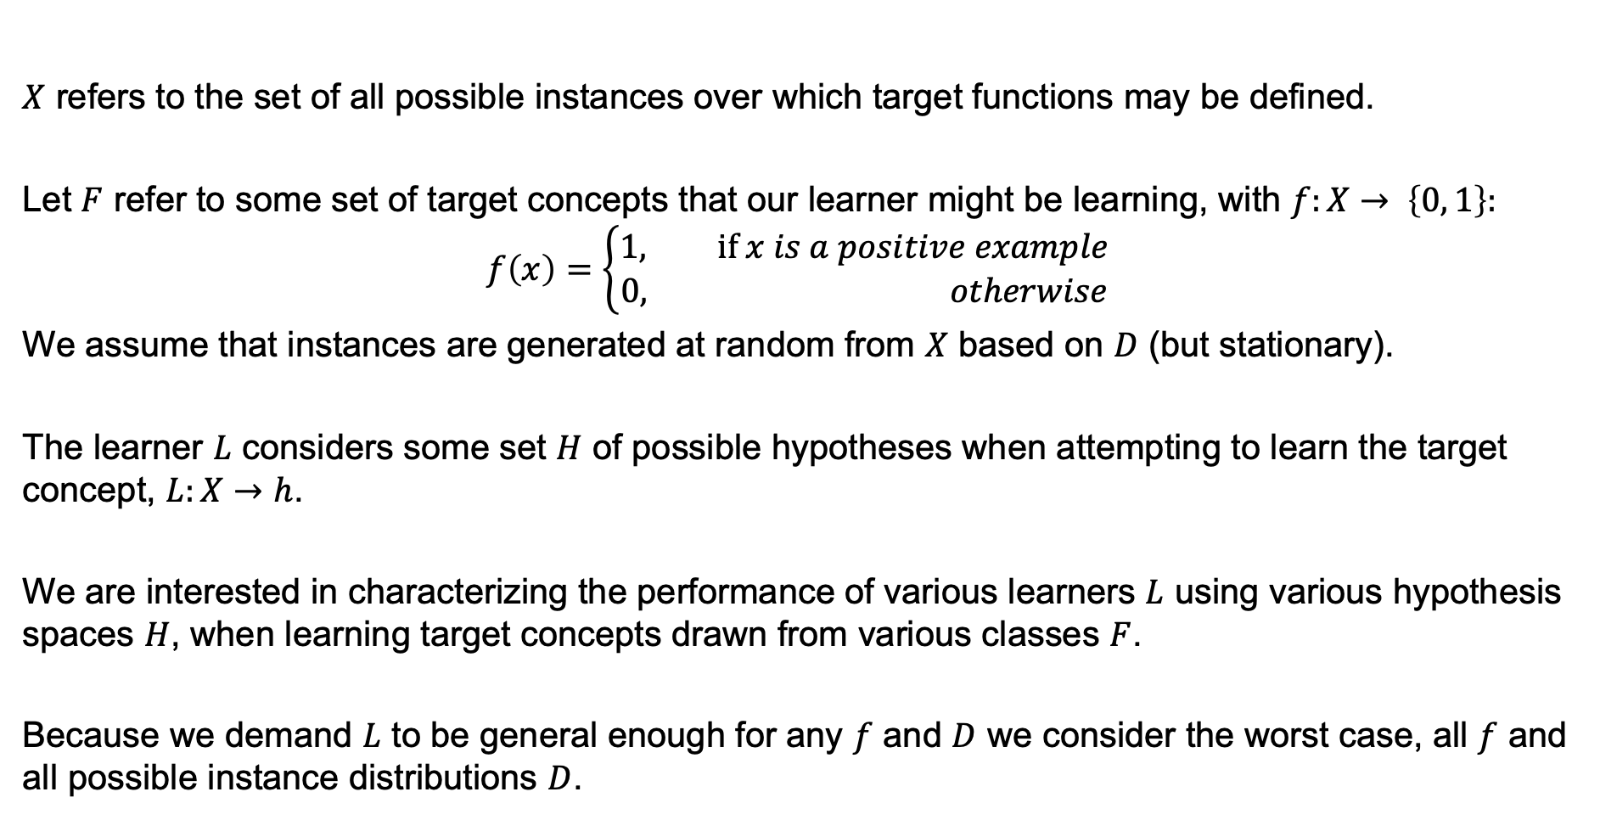
Problem Setting
$X$ refers to the set of all possible instances over which target functions may be defined.
Let $F$ refer to some set of target concepts that our learner might be learning, with $f:X→ \left\{0, 1\right\}:$
$$f\left(x\right)=\left\{\begin{aligned}1, if x is a positive example \\ &0, otherwise\end{aligned}\right.$$
We assume that instances are generated at random from $X$ based on $D$ (but stationary).
The learner $L$ considers some set $H$ of possible hypotheses when attempting to learn the target concept, $L:X→h$.
We are interested in characterizing the performance of various learners $L$ using various hypothesis spaces $H$, when learning target concepts drawn from various classes $F$.
Because we demand $L$ to be general enough for any $f$ and $D$ we consider the worst case, all $f$ and all possible instance distributions $D$.

Slide 18
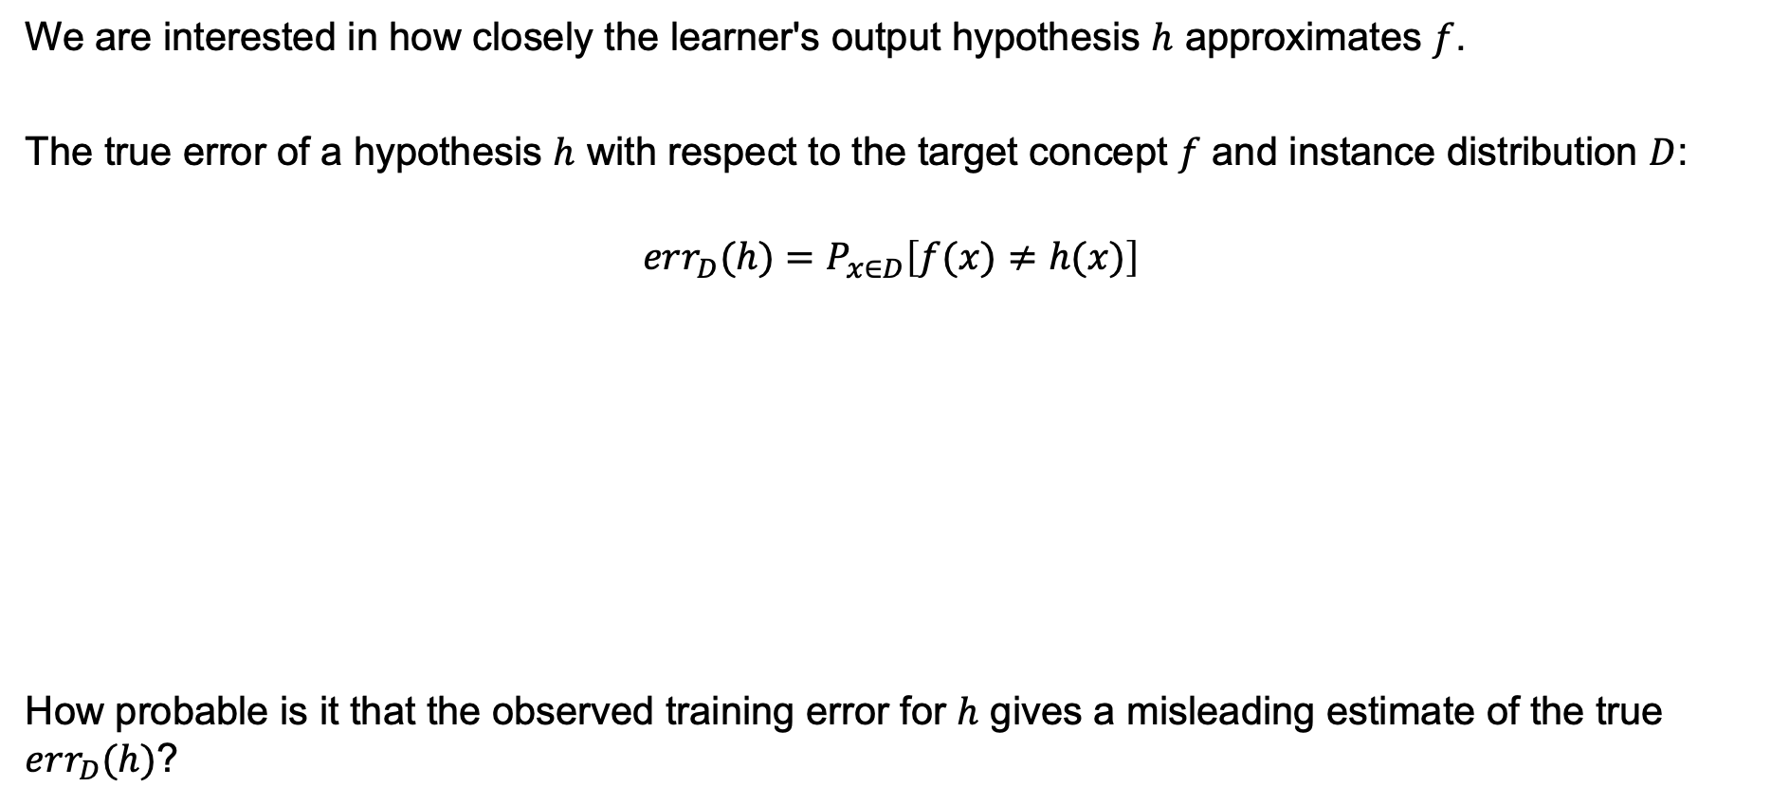


Error of a Hypothesis
We are interested in how closely the learner's output hypothesis $h$ approximates $f$.
The true error of a hypothesis $h$ with respect to the target concept $f$ and instance distribution $D$:
$$err_{D}(h)=P_{x∈D}\left[f(x)≠h(x)\right]$$
How probable is it that the observed training error for $h$ gives a misleading estimate of the true $err_{D}(h)$?
$$f$$
$$f$$

Slide 19
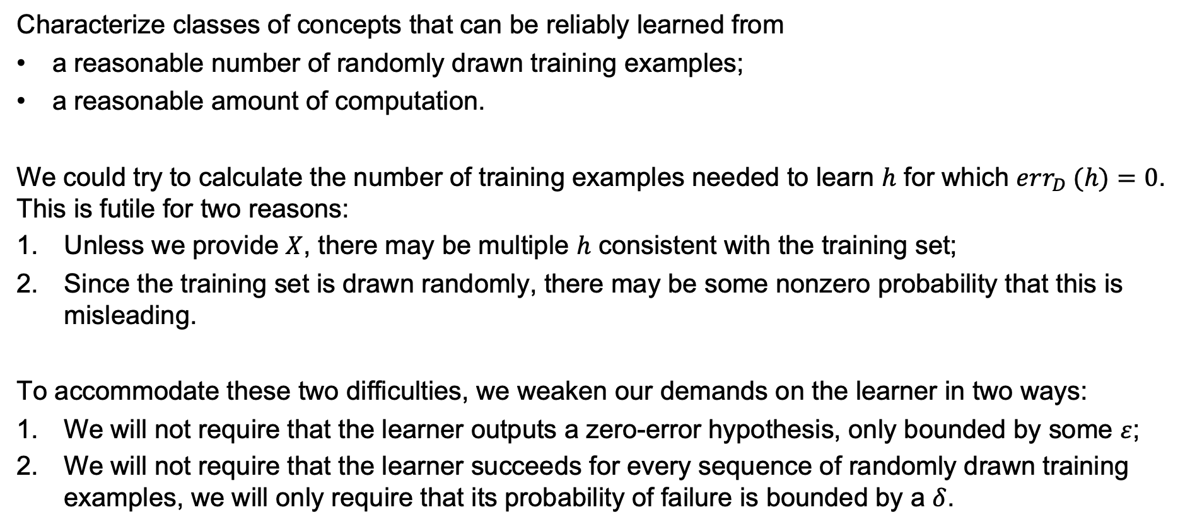
PAC Learnability
Characterize classes of concepts that can be reliably learned from
a reasonable number of randomly drawn training examples;
a reasonable amount of computation.
We could try to calculate the number of training examples needed to learn $h$ for which $err_{D} (h)=0$. This is futile for two reasons:
Unless we provide $X$, there may be multiple $h$ consistent with the training set;
Since the training set is drawn randomly, there may be some nonzero probability that this is misleading.
To accommodate these two difficulties, we weaken our demands on the learner in two ways:
We will not require that the learner outputs a zero-error hypothesis, only bounded by some $ε$;
We will not require that the learner succeeds for every sequence of randomly drawn training examples, we will only require that its probability of failure is bounded by a $δ$.

Slide 20
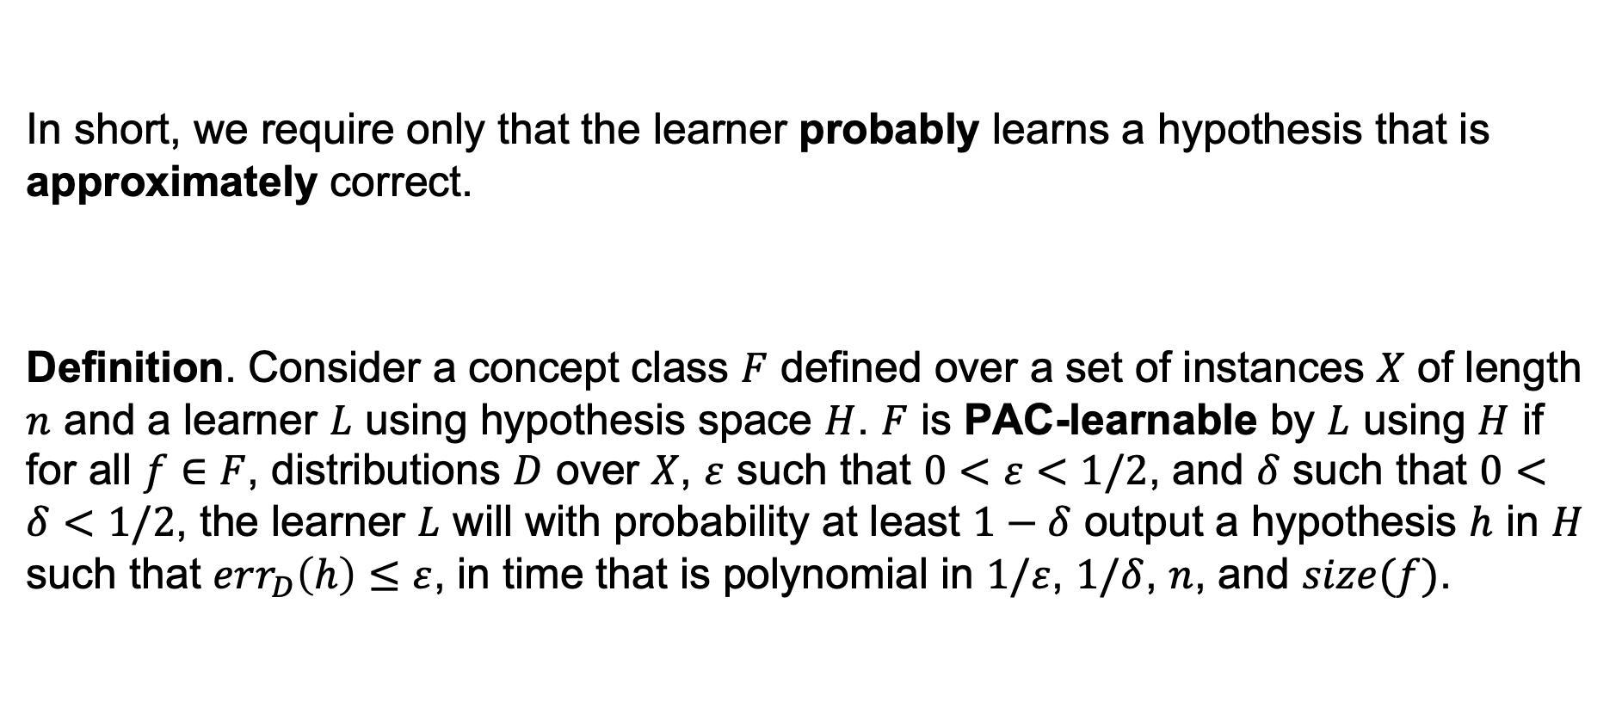
PAC Learnability
In short, we require only that the learner probably learns a hypothesis that is approximately correct.
Definition. Consider a concept class $F$ defined over a set of instances $X$ of length $n$ and a learner $L$ using hypothesis space $H$. $F$ is PAC-learnable by $L$ using $H$ if for all $f∈F$, distributions $D$ over $X$, $ε$ such that $0<ε<1/2$, and $δ$ such that $0<δ<1/2$, the learner $L$ will with probability at least $1−δ$ output a hypothesis $h$ in $H$ such that $err_{D}\left(h\right)≤ε$, in time that is polynomial in $1/ε$, $1/δ$, $n$, and $size(f)$.

Slide 21
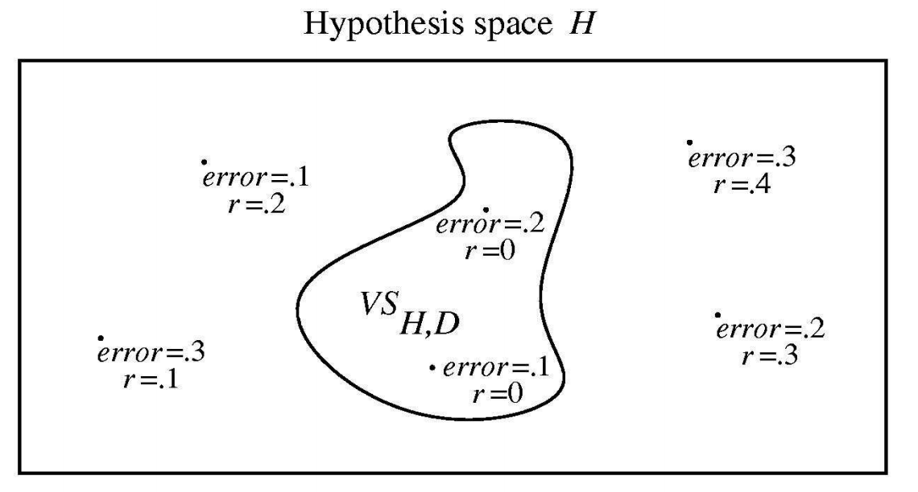
Sample Complexity for Finite Hypothesis Spaces
Sample complexity is the growth in the number of required training examples with the problem size.
Learners are said consistent if they output hypotheses that perfectly fit the training data, whenever possible.
Can we derive a bound on the number of training examples required by any consistent learner, independent of the specific algorithm it uses to derive a consistent hypothesis?
Let's recall the definition of Version Space:

Slide 22

$ε$-Exhausted Version Space
To bound the number of examples needed by any consistent learner, we need only to bound the number of examples needed to assure that the version space contains no unacceptable hypotheses.
Definition. Consider a hypothesis space $H$, a target concept $f$, an instance distribution $D$, and a set of training examples $D$ of $f$. The version space $VS_{H,D}$ is said to be $ε$-exhausted with respect to $f$ and $D$, if:
$$∀h∈VS_{H,D}, err_{D}\left(h\right)<ε$$

Slide 23
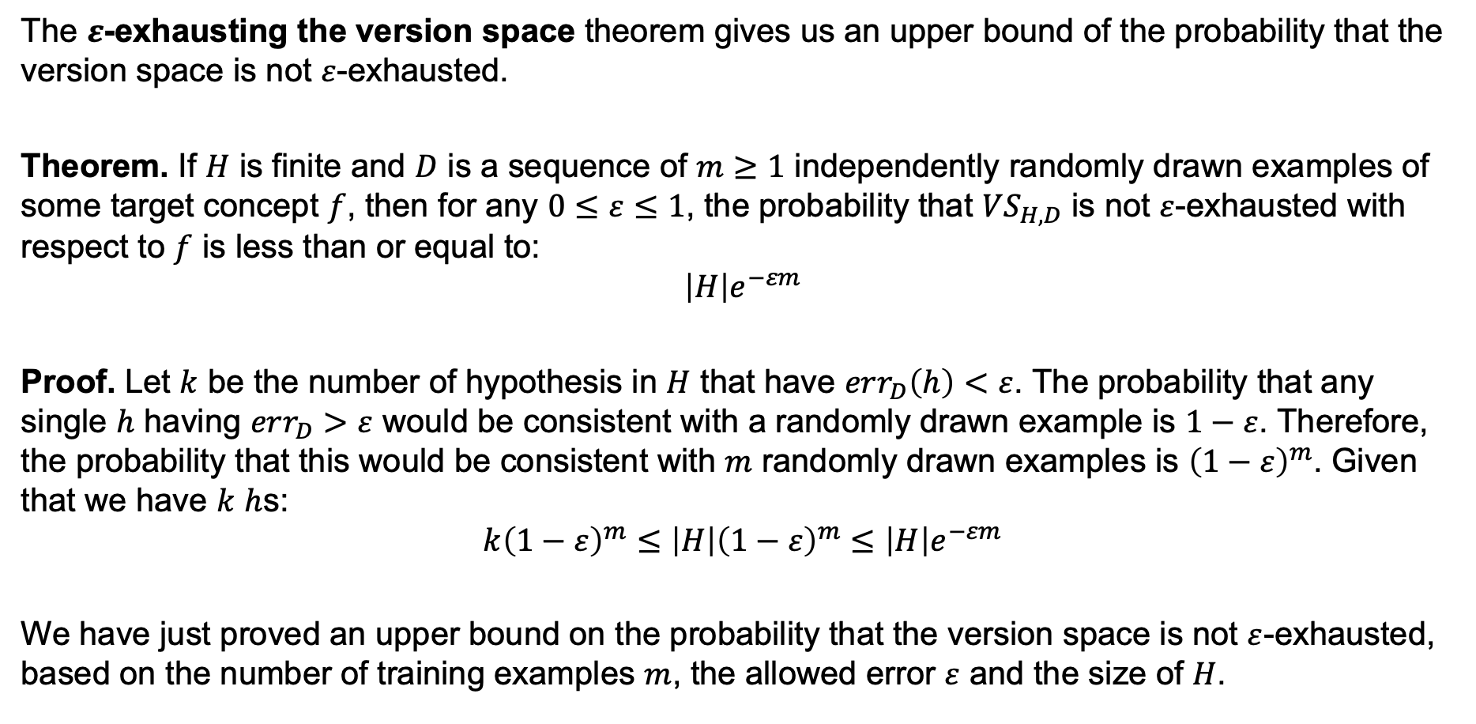
How Many Examples are Enough?
The $ε$-exhausting the version space theorem gives us an upper bound of the probability that the version space is not $ε$-exhausted.
Theorem. If $H$ is finite and $D$ is a sequence of $m≥1$ independently randomly drawn examples of some target concept $f$, then for any $0≤ε≤1$, the probability that $VS_{H,D}$ is not $ε$-exhausted with respect to $f$ is less than or equal to:
$$\left|H\right|e^{−εm}$$
Proof. Let $k$ be the number of hypothesis in $H$ that have $err_{D}\left(h\right)<ε$. The probability that any single $h$ having $err_{D}>ε$ would be consistent with a randomly drawn example is $1−ε$. Therefore, the probability that this would be consistent with $m$ randomly drawn examples is ${\left(1−ε\right)}^{m}$. Given that we have $k$ $h$s:
$$k{\left(1−ε\right)}^{m}≤\left|H\right|{\left(1−ε\right)}^{m}≤\left|H\right|e^{−εm}$$
We have just proved an upper bound on the probability that the version space is not $ε$-exhausted, based on the number of training examples $m$, the allowed error $ε$ and the size of $H$.

Slide 24
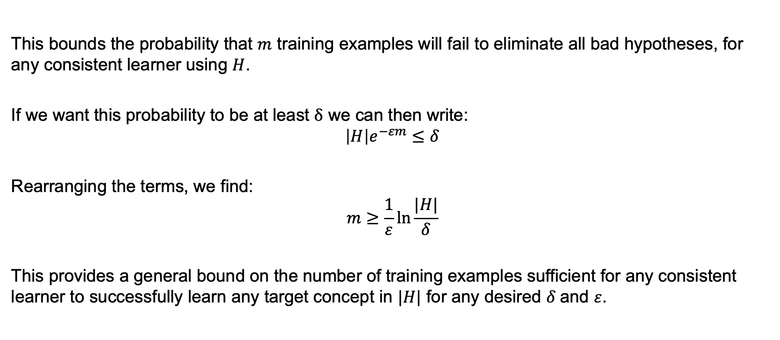
Bound on the Size of the Training Set
This bounds the probability that $m$ training examples will fail to eliminate all bad hypotheses, for any consistent learner using $H$.
If we want this probability to be at least $δ$ we can then write:
$$\left|H\right|e^{−εm}≤δ$$
Rearranging the terms, we find:
$$m≥\frac{1}{ε}\ln{\frac{|H|}{δ}}$$
This provides a general bound on the number of training examples sufficient for any consistent learner to successfully learn any target concept in $|H|$ for any desired $δ$and $ε$.

Slide 25
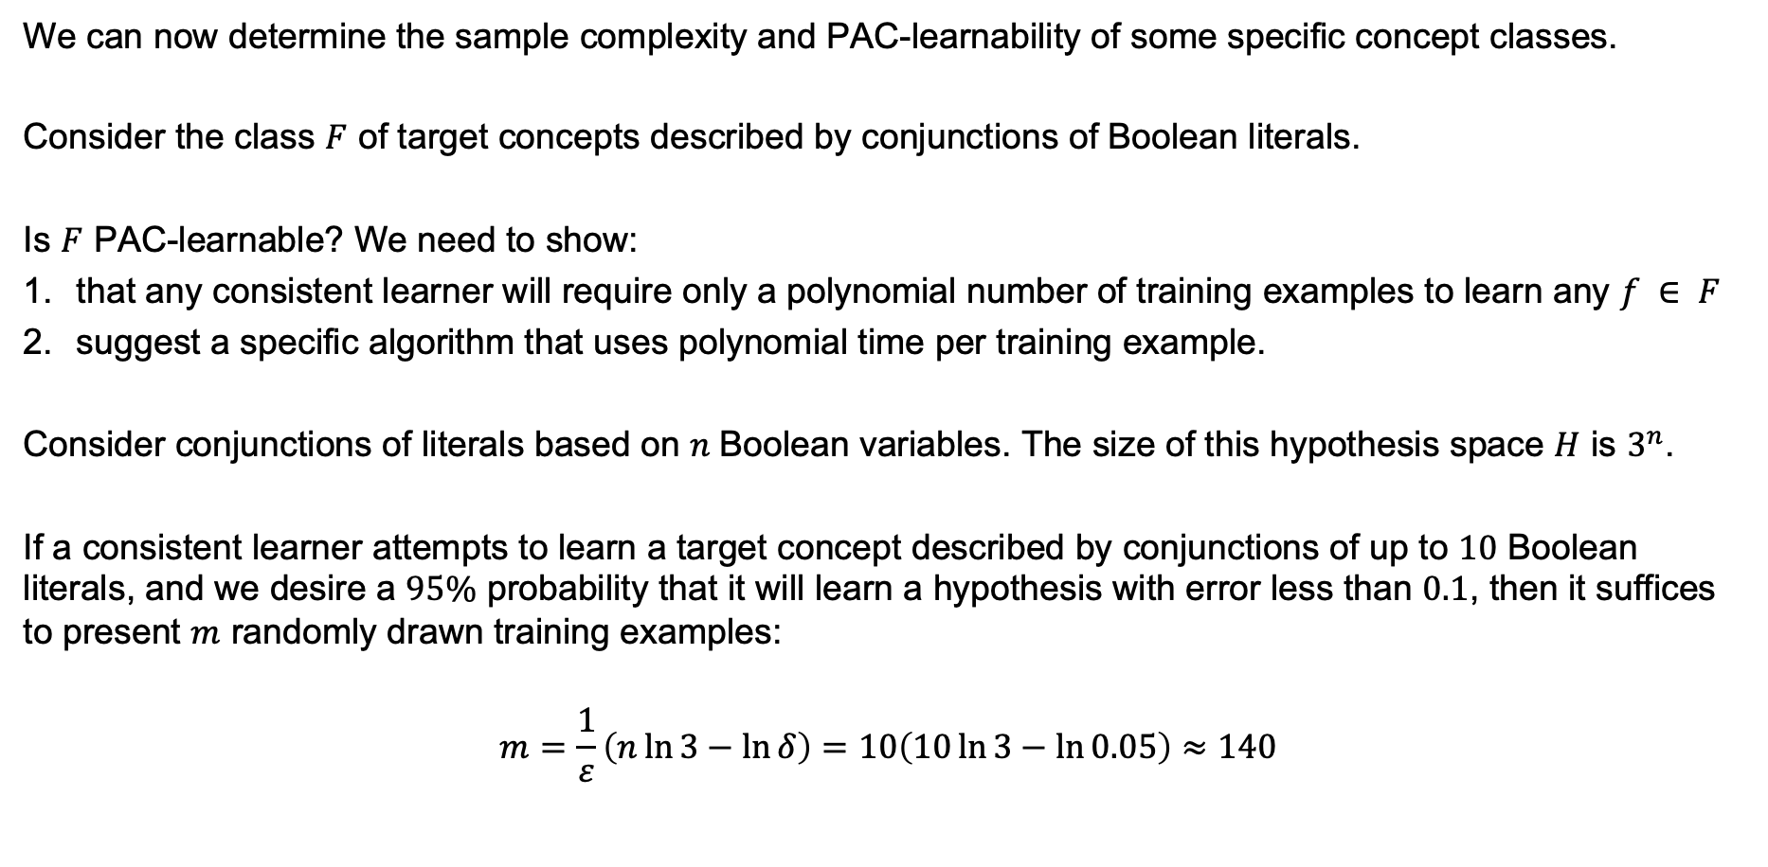
Learning Conjunctions
We can now determine the sample complexity and PAC-learnability of some specific concept classes.
Consider the class $F$ of target concepts described by conjunctions of Boolean literals.
Is $F$ PAC-learnable? We need to show:
that any consistent learner will require only a polynomial number of training examples to learn any $f ∈ F$
suggest a specific algorithm that uses polynomial time per training example.
Consider conjunctions of literals based on $n$Boolean variables. The size of this hypothesis space $H$ is $3^{n}$.
If a consistent learner attempts to learn a target concept described by conjunctions of up to $10$ Boolean literals, and we desire a $95\%$ probability that it will learn a hypothesis with error less than $0.1$, then it suffices to present $m$ randomly drawn training examples:
$$m=\frac{1}{ε}\left(n\ln{3}−\ln{δ}\right)=10\left(10\ln{3}−\ln{0.05}\right)≈140$$

Slide 26
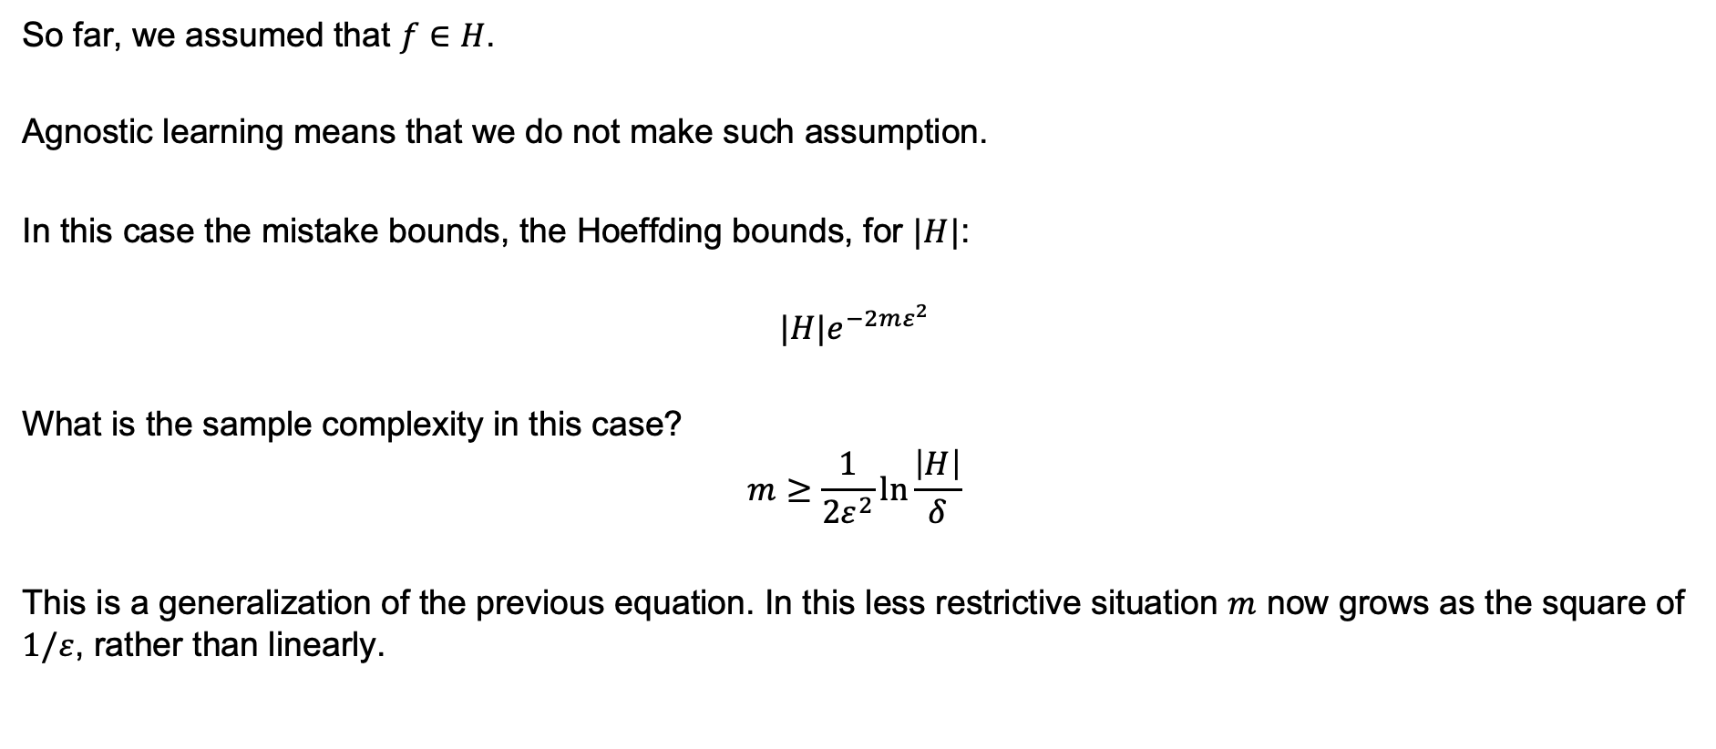
Agnostic Learning and Inconsistent Hypothesis
So far, we assumed that $f∈H$.
Agnostic learning means that we do not make such assumption.
In this case the mistake bounds, the Hoeffding bounds, for $|H|$:
$${|H|e}^{−2mε^{2}}$$
What is the sample complexity in this case?
$$m≥\frac{1}{{2ε}^{2}}\ln{\frac{\left|H\right|}{δ}}$$
This is a generalization of the previous equation. In this less restrictive situation $m$ now grows as the square of $1/ε$, rather than linearly.

Slide 27
Summary
No Free Lunch Theorem
Bias vs. Variance
Validation
PAC Learning

